Slide 1

Predictions of TCPro are Most Sensitive to the Frequency of Drug-Specific CD4⁺ Cells
We ran a parameter sensitivity analysis in silico and calculated how much the parameter variations would affect the predicted percent cohort response.
We observed that the frequency of drug specific T cells shows a significant positive correlation with the predicted immune response.
The other significant parameters are
the mean concentration of maturation signal in the wells,
the rates of death and differentiation of the CD4⁺ cells.
Notes:
First of all we needed to better understand the effects of different parameters on the immunogenicity predictions of TCPro,

Slide 2
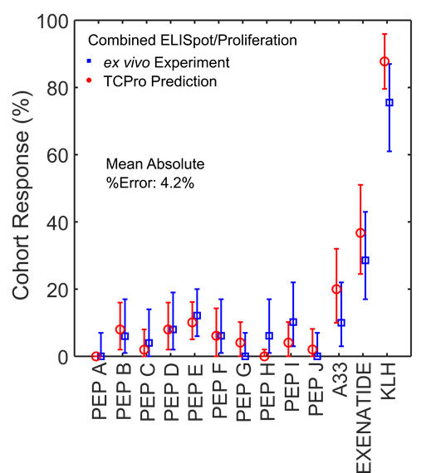
TCPro Validation: ex vivo T Cell Activation Assays Data
Immunogenicity assay data (FDA-OTAT)
Blood samples from 50 healthy donors
Donors are HLA allele-typed
13 products tested (protein or peptide)
%donors demonstrating immune response calculated
Simulate the same assays with TCPro
More than a million assay wells simulated
Absolute %Error in the mean is 4.2%
Notes:
To validate TCPro we obtained ex vivo assay data on 50 healthy donors whose HLA alleles are known to us. This dataset has 13 product samples and percent donors who responded to the samples are available.
We performed the same exact assay protocol using TCPro and simulated this ex vivo assay system on the computer.
In the figure here, along the vertical, we have the percent cohort that responded to a particular drug we tested. The lines in blue show the percent cohort response from the ex vivo assay and the red ones are the predictions of TCPro.
In general we saw that TCPro’s predictions compared well with the results of the ex vivo assay.

Slide 3

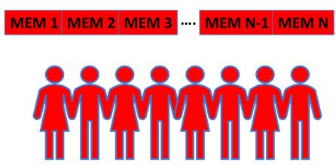
Virtual Patient Cohort Development
1272 Virtual Patients Generated:
Patient HLA-DRB allele information obtained from the 1000 Genomes dataset
Patient immune cell plasma concentrations randomly sampled from typical ranges obtained from the literature
www.fda.gov
1000 Genomes Project
An international research consortium with the aim of sequencing the genomes of at least 1,000 volunteers from around the world
www.internationalgenome.org/data
Notes:
Encouraged by our validation, we decided to generate our customized cohorts and test some products that were not on our validation dataset. For this we used the 1000 genomes project. The 1000 genomes project volunteers come from a diverse ethno-geographic backgrounds.
Although the latest version of the dataset carries genotype data on more than 2500 people, in the TCPro simulations that you will see in a moment, we used an earlier version of the dataset and obtained HLA alleles of 1272 people. We assigned random PBMC plasma concentrations to these people to develop our virtual WORLD patient cohort.

Slide 4
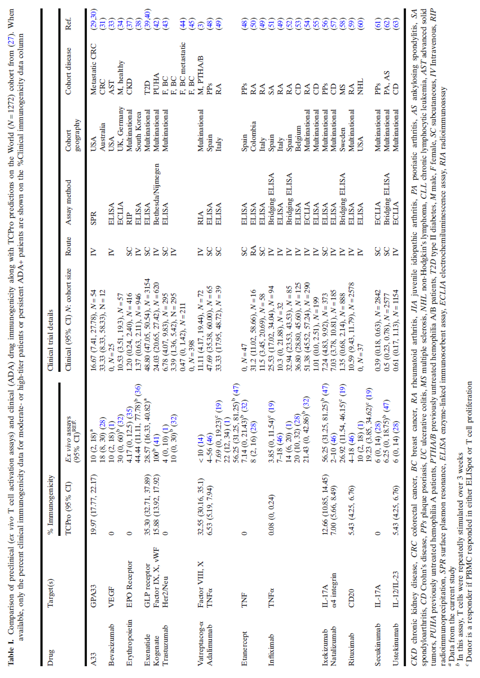
TCPro predictions showed strong correlations with the preclinical and clinical measurements of immunogenicity on 15 protein-drugs that are sold on the market (or withdrawn)
Notes:
Next, we compiled a set of drugs with published immunogenicity risk levels both from ex vivo and in vivo measurements. We have seen strong correlations between TCPro’s predictions on our Virtual World Cohort and those published measurements.

Slide 5
A Good Prediction
huA33 – Colorectal Cancer Drug
A Not-So-Good Prediction
Adalimumab

Slide 6
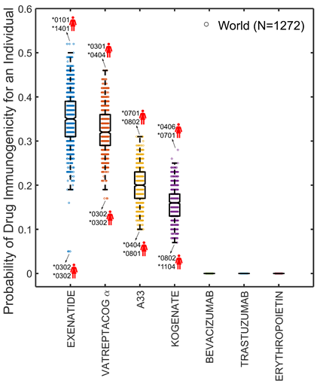
Prediction: Large variability in immunogenicity of individual patients
We treated our virtual world cohort with different full-length protein-based biotherapeutics
Our analysis showed a large degree of variability in patient responses for some of the drugs*
*Each dot on the figure represents the probability of immunogenicity of one virtual patient with distinct set of HLA-DRB1 alleles.
Notes:
We treated our virtual world cohort with different full-length protein-based biotherapeutics and obtained the immunogenicity risk probability of each member of the world cohort.
Our analysis showed a large degree of variability in patient responses for some of the drugs*
Here the dots on the figure represent the probability of immunogenicity of one virtual patient with distinct set of HLA-DRB1 alleles.

Slide 7
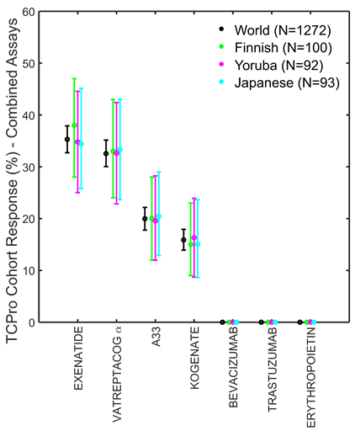
Prediction: Insignificant differences among different ethno-geographic cohorts
We analyzed three subpopulations within our world cohort (Finnish, Yoruba, and Japanese) and compared our immunogenicity risk predictions against the world cohort.
Our analysis showed that although individual immune responses vary widely, differences in percent responders at the population level are not significant among geographically sampled cohorts.
*Each dot on the figure represents the probability of immunogenicity of one virtual patient with distinct set of HLA-DRB1 alleles.
Notes:
We analyzed three subpopulations within our world cohort (namely Finnish, Yoruba, and Japanese) and compared our immunogenicity risk predictions against the world cohort.
The figure is a little different from the plot I showed a slide ago. Here along the vertical we have the TCPro predicted %cohort responses for the world population, the Finish, Yoruba and Japanese populations.
Our analysis showed that although individual immune responses vary widely, differences in percent responders at the population level are not significant among geographically sampled cohorts.

Slide 8
The Limitations of TCPro
TCPro predicts immunogenicity based on patient HLA genotype and the protein sequences (most important factors),
… but immunogenicity depends on many other factors including…
Product composition, patient comorbidities +more
Repeated drug administrations over long time frames (re-stimulation)
Route of administration
Notes:
For example, in some hemophilia A patients the neutralizing antibodies develop as late as the hundredth exposure to the product.
concomitant medications
Inhaled human insulin… more immunogenic than sc insulin
ADA/aggregate correlation for β-interferon and h-Insulin

Slide 9
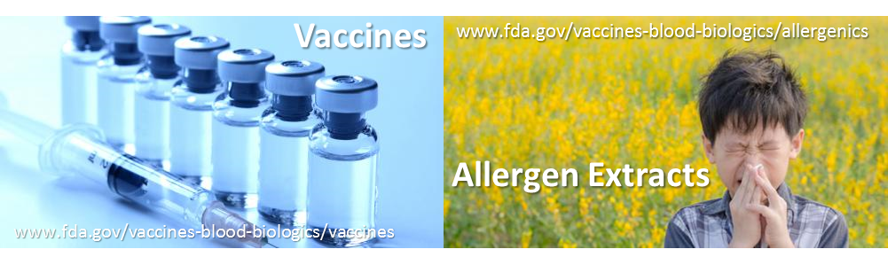

Future Steps
Modeling desired immunogenicity
Allergenics and vaccines
Modeling principles similar to TCPro
Supplementing ex vivo assay data with MAPPs assay data for mechanistic model improvement
Immunogenicity development and progression in pregnant people, neonates, and infants (Dr. Padilla)
Dr. Dustin Padilla
Notes:
One natural extension of the work I presented today is on the allergenics and vaccinology front which OUR center at FDA regulates.
Also, we are certainly very interested in incorporating other immunogenicity assay modalities into TCPro, for example peptide proteomics/mass spectrometry data.
Dr. Dustin Padilla has recently joined our team and he is using some of the principles in TCPro and applying those in immunogenicity development and progression in pregnant people, neonates, and infants.

Slide 10
Conclusions
TCPro predicts a protein-based drug’s risk of immunogenicity.
It is validated on ex vivo T cell assay results.
It compares well with observed immunogenicity risk levels.
It can perform risk prediction extrapolation to various patient cohorts.
We observed a large patient-to-patient variation in the immunogenicity risk.
However, on average, we saw that the immunogenicity risk differences between patient cohorts from different ethno-geographical backgrounds were small.
Notes:
This could be due to HLA alleles cluster into superfamilies with similar preferences for antigens.

Slide 11

FDA MIDD WORKSHOP
Model Informed Drug Development Approaches
for Immunogenicity Assessments
Fully Virtual, June 9, 2021 – 14:00-23:00 CET
Registration opens soon!
Notes:
Finally, I would like to invite all of you to our immunogenicity workshop in June. We will have more than 20 speakers from the FDA, industry and academia with plenty of discussions on modeling in immunogenicity.

Slide 12

THANK YOU
You may obtain TCPro from https://github.com/FDA/TCPro
Email: osman.yogurtcu@fda.hhs.gov

